Slide 1

FINAL PROJECT PRESENTATION
DURIAN STORE
(MOBILE ONLINE SHOP)

Slide 2
Member - Group 4

Slide 3
List of Contents
Contents
01
PROJECT OVERVIEW
02
PROJECT MANAGEMENT
03
SOFTWARE REQUIREMENT SPECIFICATION
04
SOFTWARE DESIGN
05
DEMO AND Q&A

Slide 4






1.PROJECT OVERVIEW
Thesis Defense Presentation Template

Slide 5





PROJECT OVERVIEW
1.Introduction
Durian Store is an online store specializing in providing all kinds of Iphone running iOS operating system. A website-based application for users to purchase online, allowing customers to directly place orders and purchase goods at the website itself, while helping to improve the customer experience.
Coming to the Durian Store, we can see the open and easy-to-see interface. The website offers products with its basic features that are inferior to the color, value in the market. Durian Store built an admin function to be able to manage the list of all products in the store, besides also managing user accounts, comments (reviews) and orders.

Slide 6
PROJECT OVERVIEW
1.2 Scope of project
1.
CREATE AN E-COMMERCE PLATFORM THAT SELLS IPHONES
2.
CUSTOMERS AND USERS CAN VIEW PRODUCT LISTINGS, VIEW DETAILED INFORMATION OF EACH PRODUCT, AND MAKE PURCHASES
3.
USERS CAN MANAGE THEIR PERSONAL INFORMATION, TRACK ORDERS AND COMMENT ON PRODUCTS THEY HAVE PURCHASED
4.
ADMIN ROLE WEBSITE TO MANAGE PRODUCTS, ORDERS, COMMENTS TO PROVIDE A GOOD CUSTOMER EXPERIENCE

Slide 7
PROJECT OVERVIEW
1.3 out of Scope
1.
ONLINE PAYMENT
2.
ACCOUNT MANAGEMANT FOR ADMIN
3.
VOURCHER FOR EACH USER
4.
CONFIRM COMMENT FOR ADMIN
5.
SAVE ALL OF INFORMATION IN ORDER

Slide 8
2.PROJECT MANAGEMENT
Thesis Defense Presentation Template

Slide 9
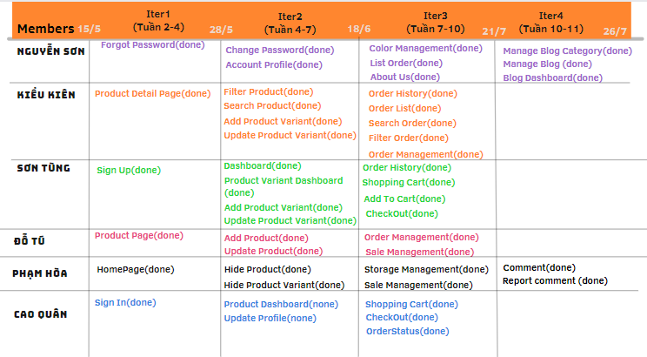
PROJECT MANAGEMENT
2.1 road map

Slide 10
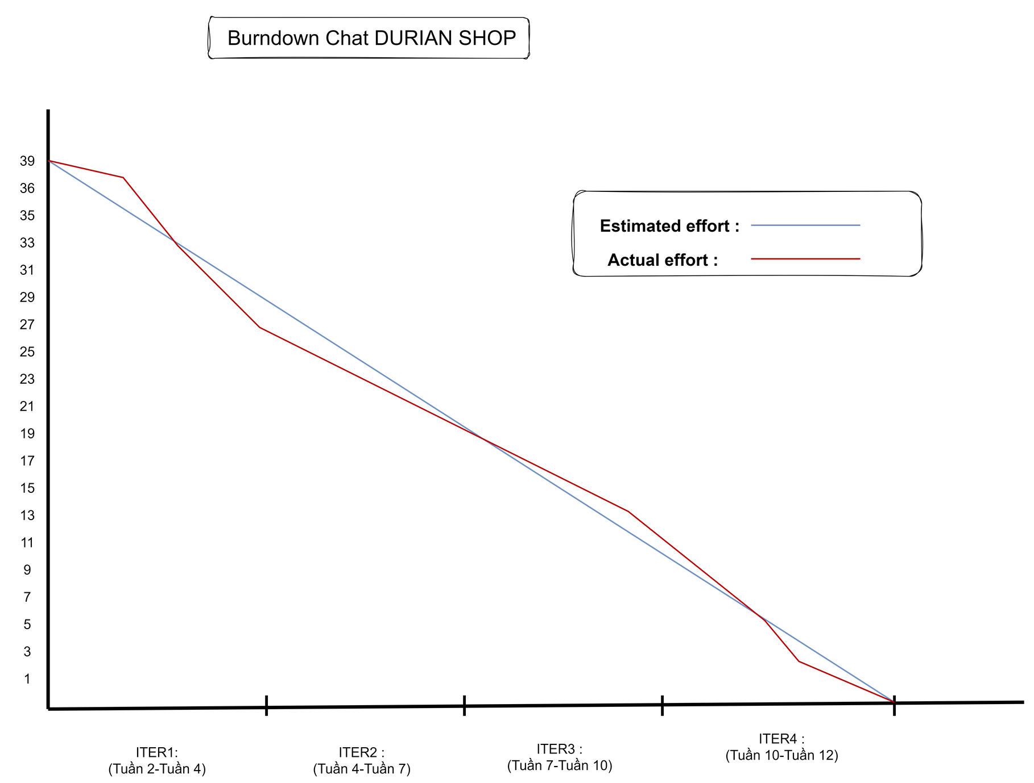
PROJECT MANAGEMENT
2.2 burn down chart

Slide 11









PROJECT MANAGEMENT
2.3 equipment and tools
visual studio code
netbean
Draw.io
google docs
google sheet
Coding
document & design
google sheet
gitlab
zalo
messenger
google meet
Project Management
communication

Slide 12



PROJECT MANAGEMENT
2.4 techniques
techniques

Slide 13
3.SOFTWARE REQUIREMENT SPECIFICATION
Thesis Defense Presentation Template

Slide 14
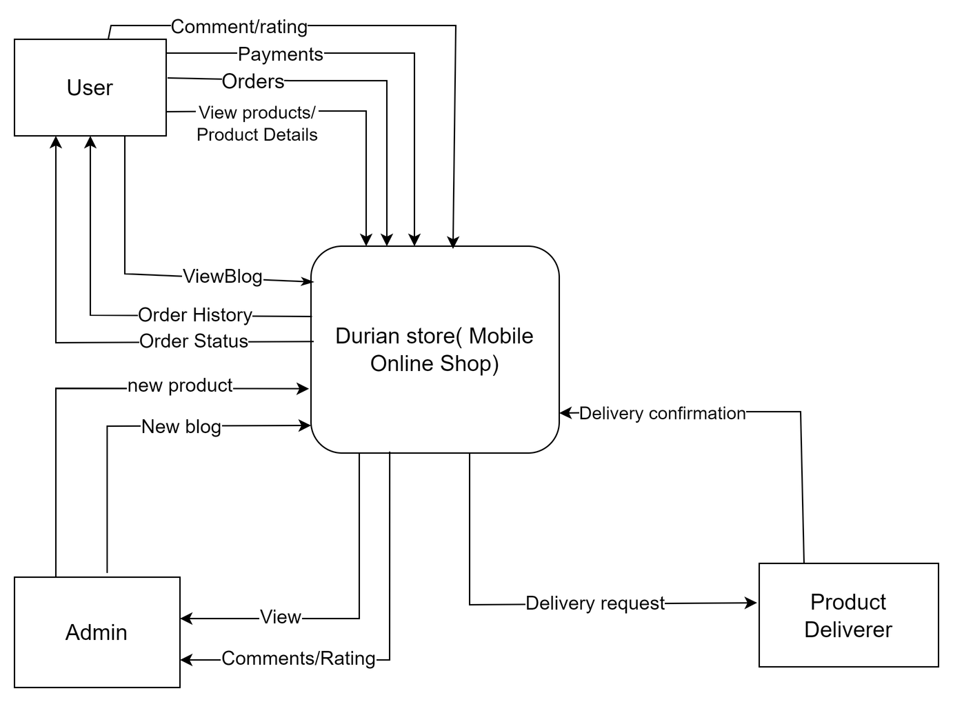
SOFTWARE REQUIREMENT SPECIFICATION
3.1 Context diagram
Context Diagram

Slide 15
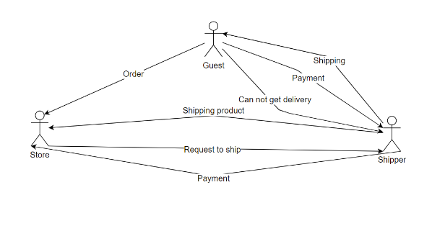
SOFTWARE REQUIREMENT SPECIFICATION
3.2 Business rich Picture
Business rich picture

Slide 16
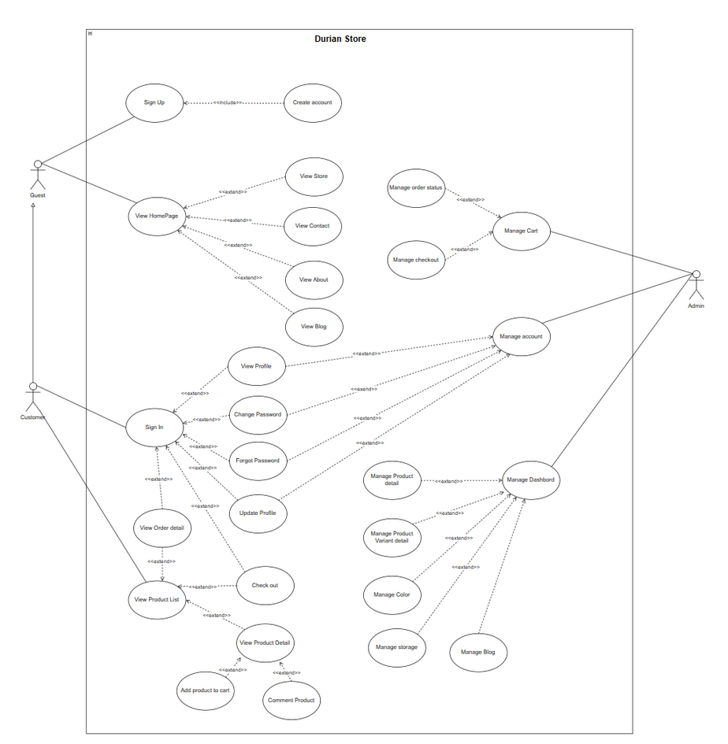
SOFTWARE REQUIREMENT SPECIFICATION
3.3 Use case diagram
High-level Usecase Diagram

Slide 17
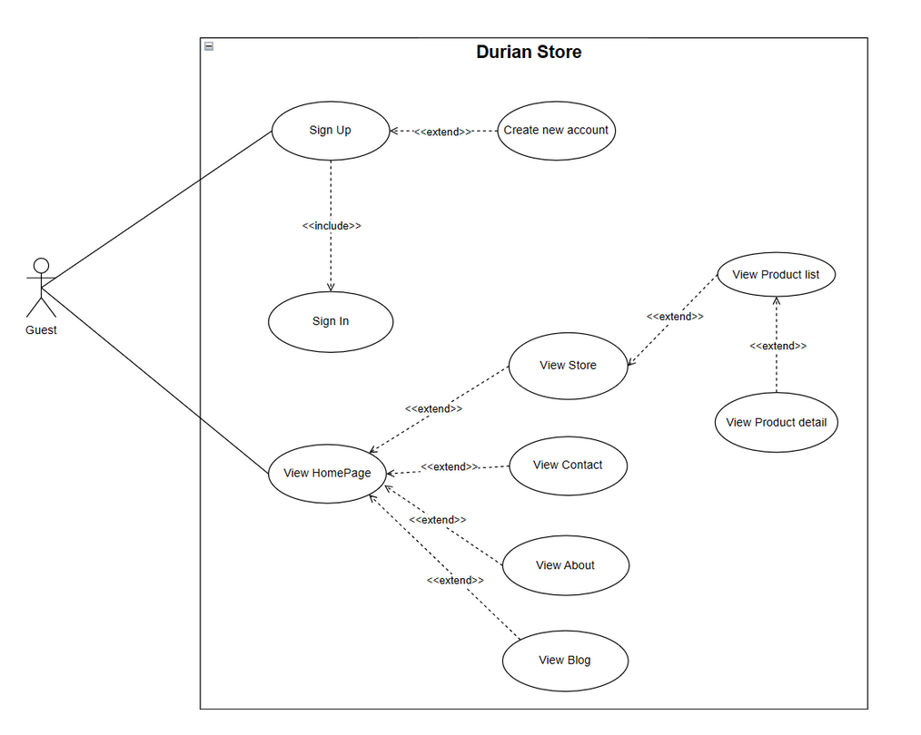
SOFTWARE REQUIREMENT SPECIFICATION
3.3 Use case diagram
Guest's Usecase Diagram

Slide 18
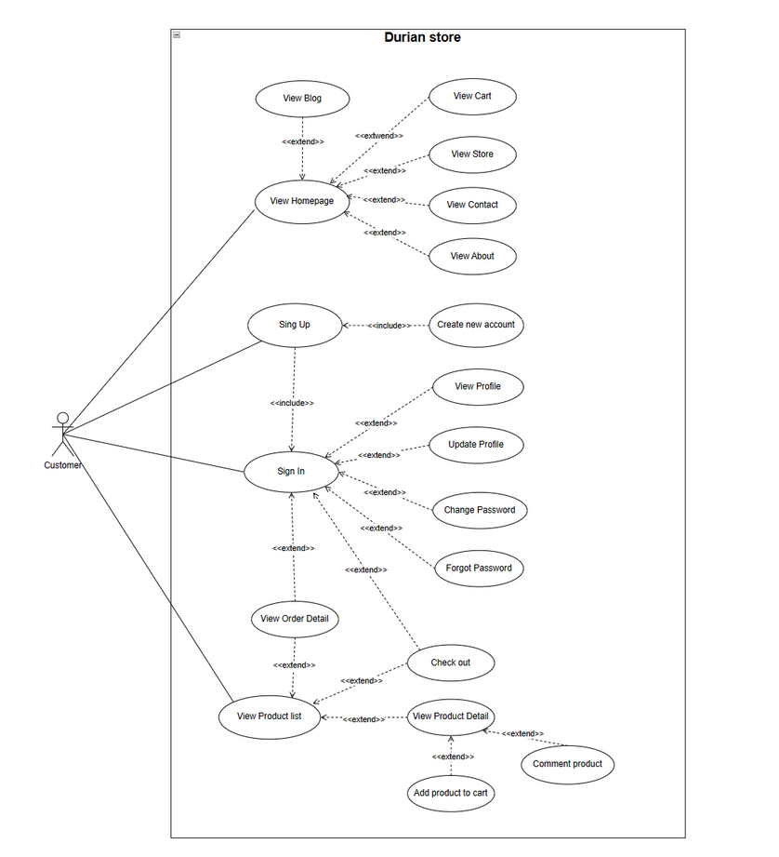
SOFTWARE REQUIREMENT SPECIFICATION
3.3 Use case diagram
User's Usecase Diagram

Slide 19
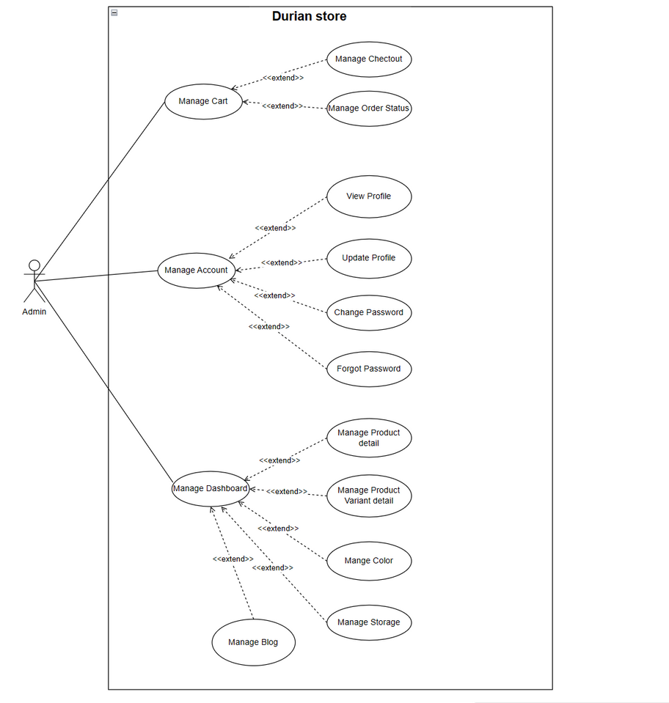
SOFTWARE REQUIREMENT SPECIFICATION
3.3 Use case diagram
Admin's Usecase Diagram

Slide 20
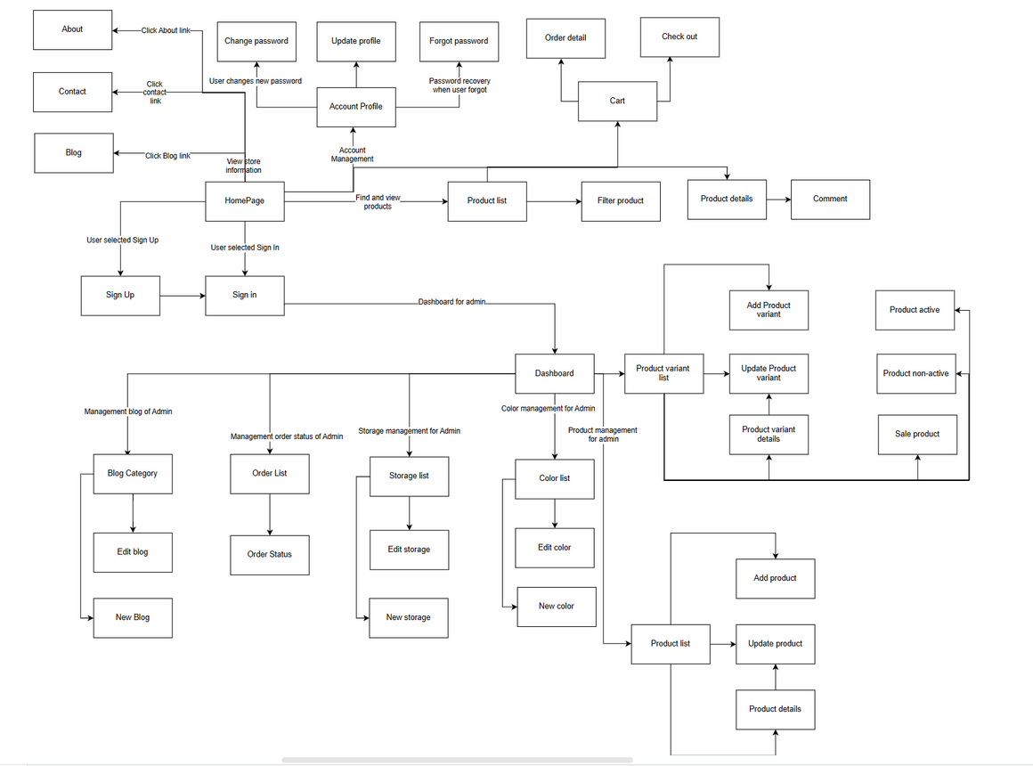
SOFTWARE REQUIREMENT SPECIFICATION
3.4 Screen flow
Screen flow

Slide 21
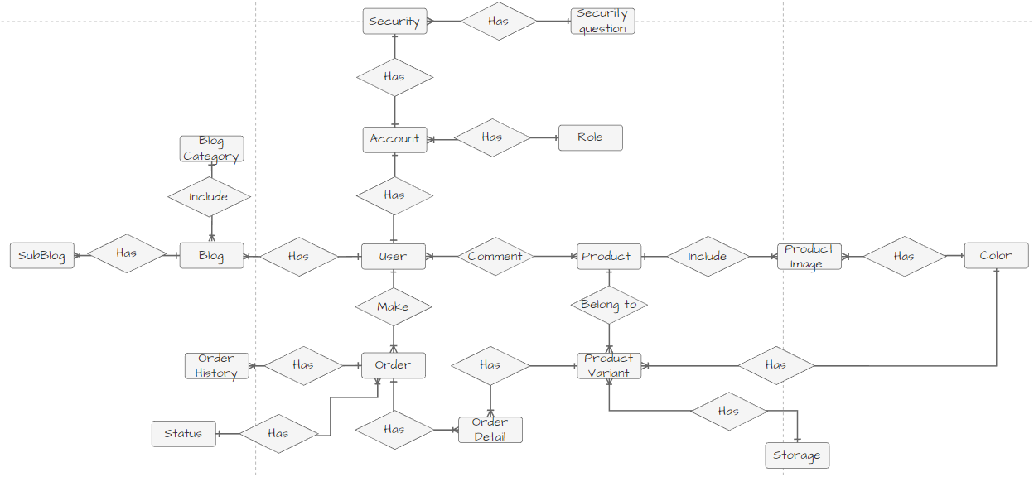
SOFTWARE REQUIREMENT SPECIFICATION
3.5 Entity relationship diagram
Entity relationship diagram

Slide 22
4.SOFTWARE DESIGN
Thesis Defense Presentation Template

Slide 23
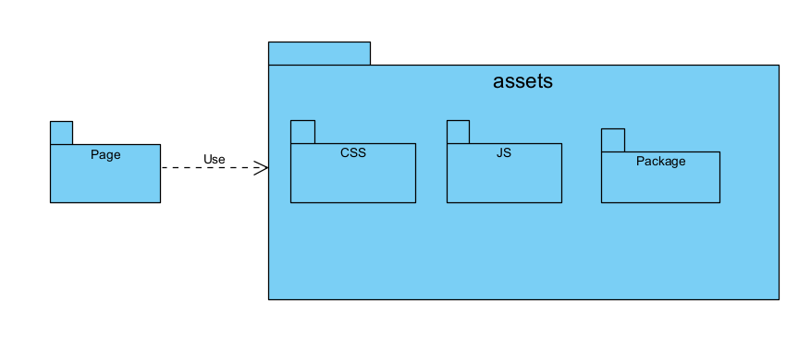
SOFTWARE DESIGN
4.1 Package Diagram
Front-end package diagram

Slide 24
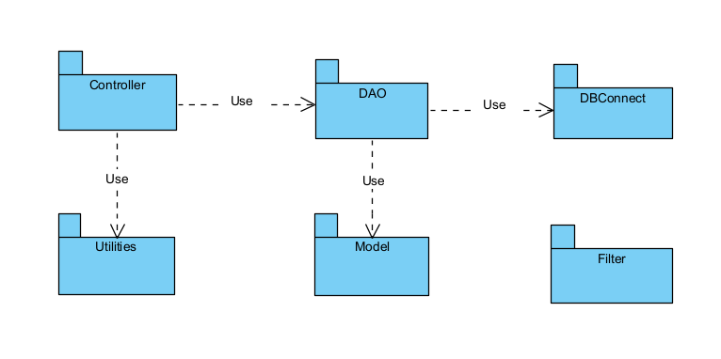
SOFTWARE DESIGN
4.1 Package Diagram
Back-end package diagram

Slide 25
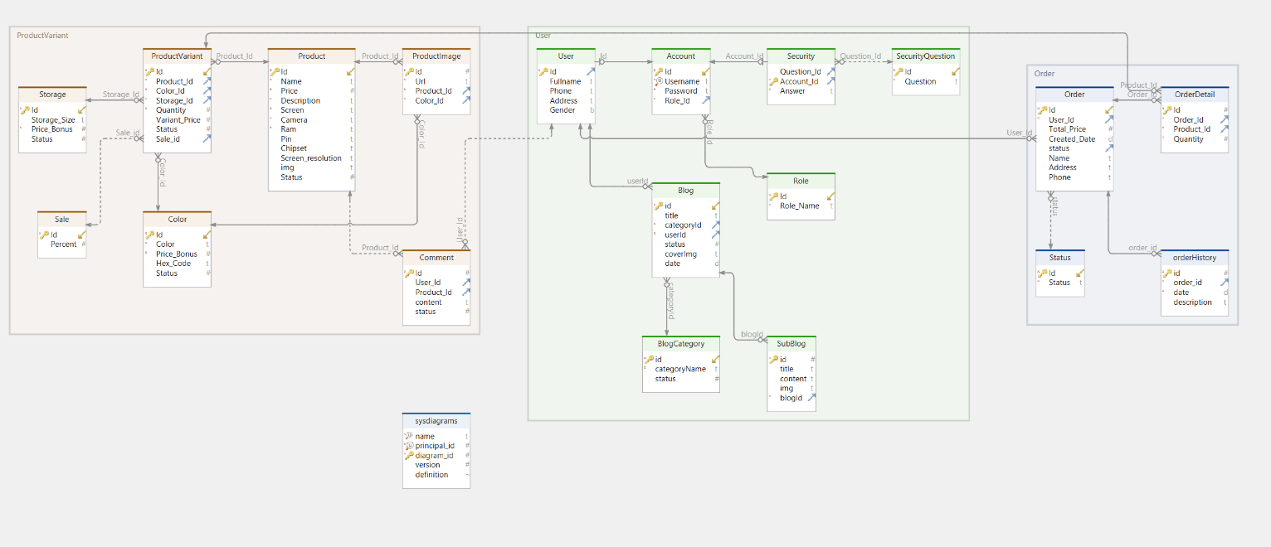
SOFTWARE DESIGN
4.2 Database Schema
Database Schema

Slide 26
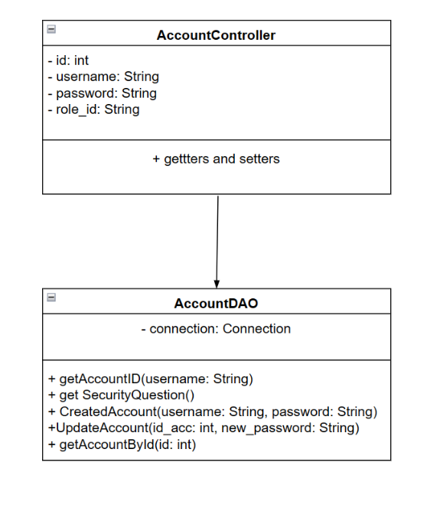
SOFTWARE DESIGN
4.3 Sign In(Design )
Cart Class Diagram

Slide 27
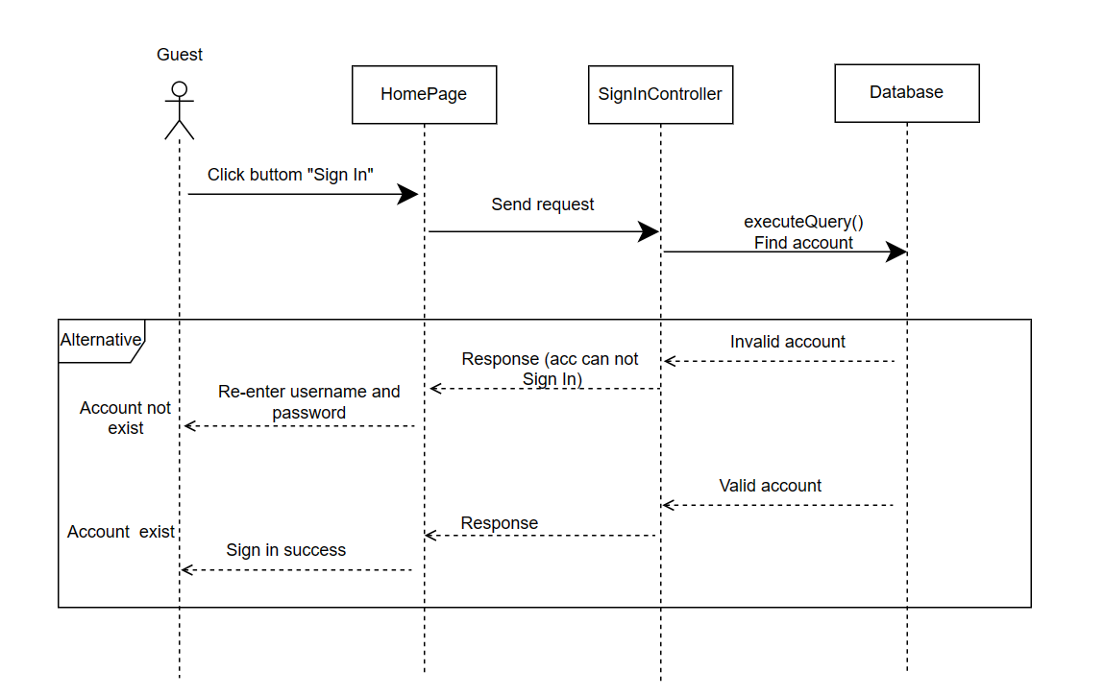
SOFTWARE DESIGN
4.3 Sign In(Design )
Cart Sequence diagram

Slide 28
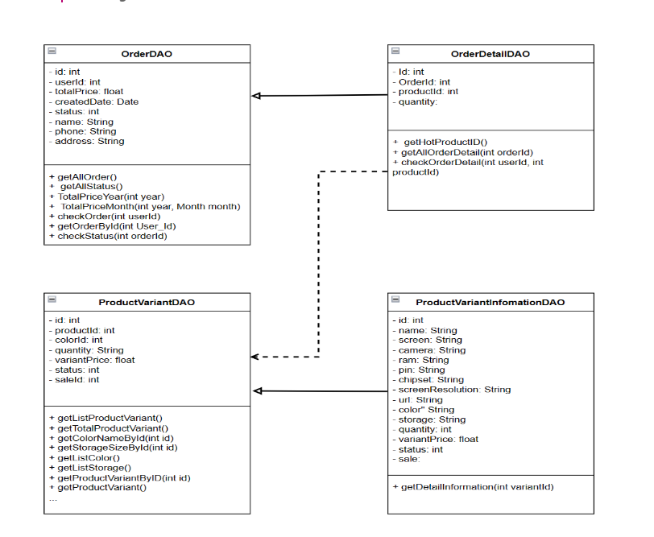
SOFTWARE DESIGN
4.4 Cart(Design )
Cart Class Diagram

Slide 29
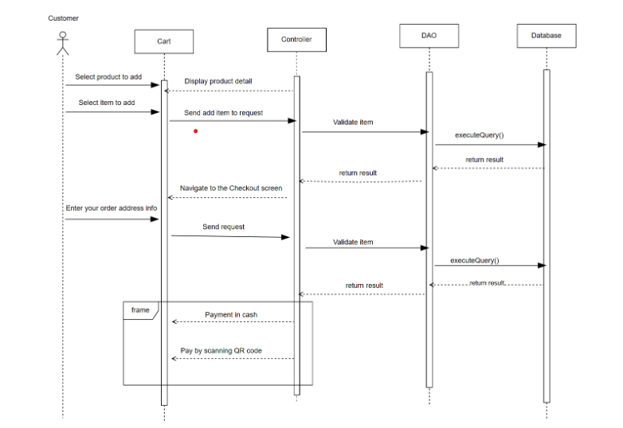
SOFTWARE DESIGN
4.4 Cart(Design )
Cart Sequence diagram

Slide 30
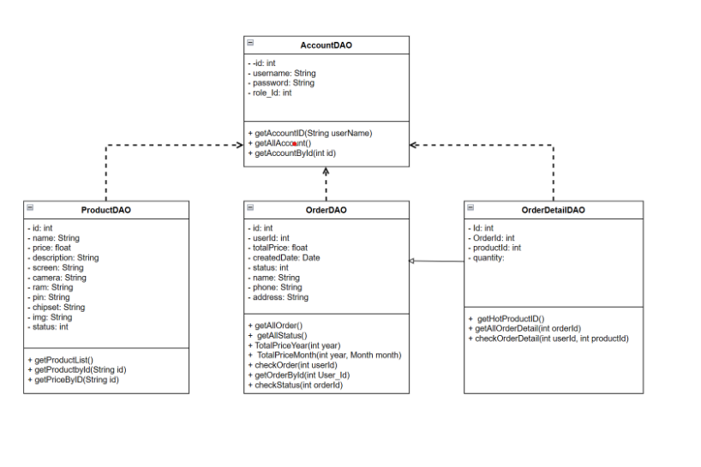
SOFTWARE DESIGN
4.5 Order List & Order Status(Design )
Order List & Order Status class diagram

Slide 31
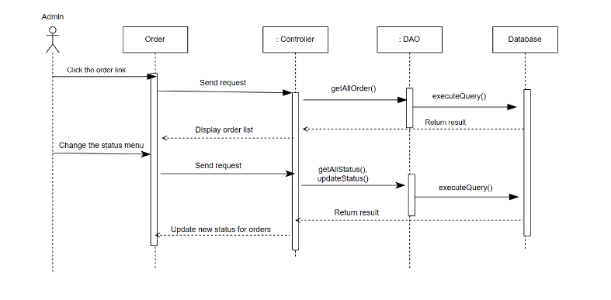
SOFTWARE DESIGN
4.5 Order List & Order Status(Design )
Order List & Order Status Squence Diagram

Slide 32
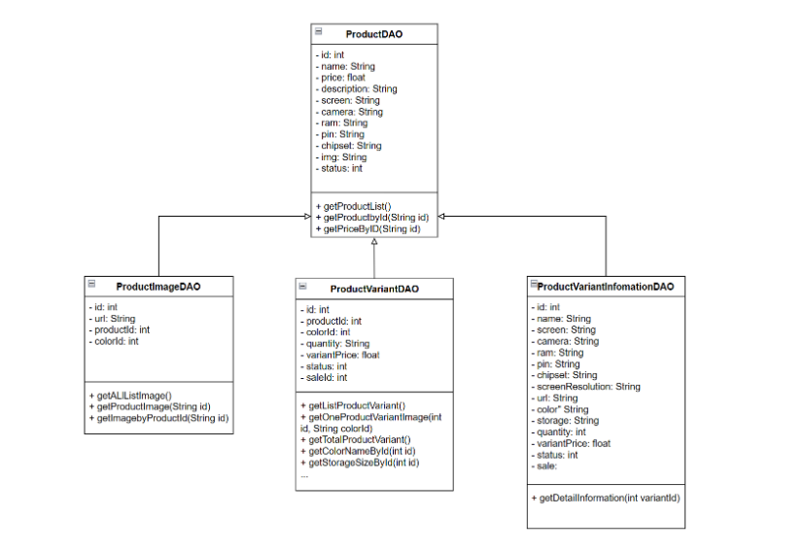
SOFTWARE DESIGN
4.6 Product(Design )
Product class diagram

Slide 33
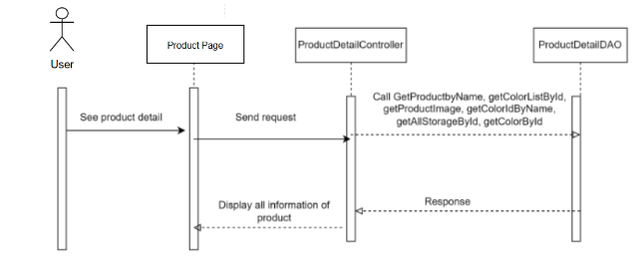
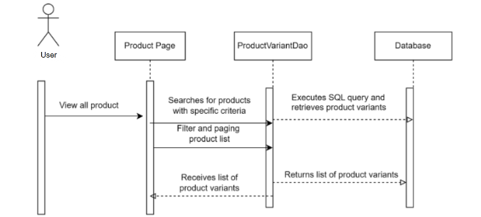
SOFTWARE DESIGN
4.6 Product(Design )
View all product
Squence Diagram
Product class diagram
Squence Diagram

Slide 34
5.DEMO
Q&A
Thesis Defense Presentation Template

